Slide 1
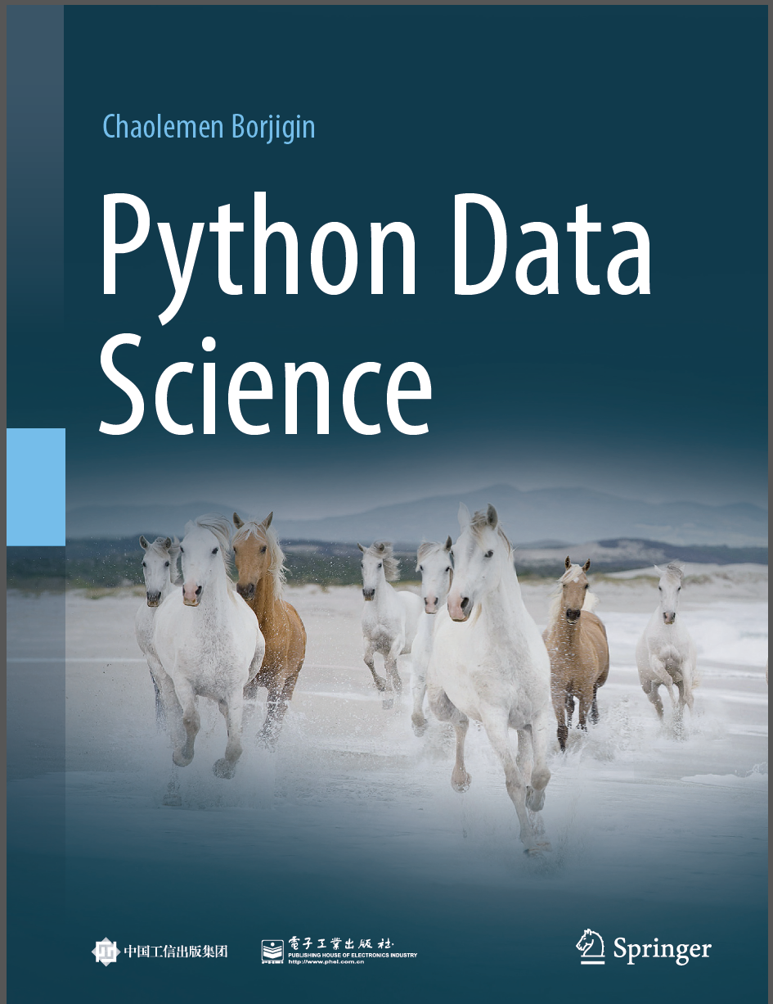
Python Programming —— From Data Analysis to Data Science
Chaolemen Borjigin
Renmin University of China
chaolemen@ruc.edu.cn

Slide 2
5.4 Image processing with OpenCV
Chaolemen Borjigin
Renmin University of China
chaolemen@ruc.edu.cn

Slide 3
Summary of this chapter
▼Chapter 5 Data analysis with Python
► 5.4 Image processing with OpenCV
5.4.1 Installing and importing opencv-python package
5.4.2 Loading image from file
5.4.3 Converting a RGB image into Grayscale
5.4.4 Detecting faces
5.4.5 Showing images
5.4.6 Writing images

Slide 4
5.4.1 Installing and importing opencv-python package
▼Chapter 5 Data analysis with Python
► 5.4 Image processing with OpenCV
In[1]:
import cv2

Slide 5
5.4.2 Loading image from fle
▼Chapter 5 Data analysis with Python
► 5.4 Image processing with OpenCV
In[2]:
image = cv2.imread(\"images/test.jpg\")

Slide 6
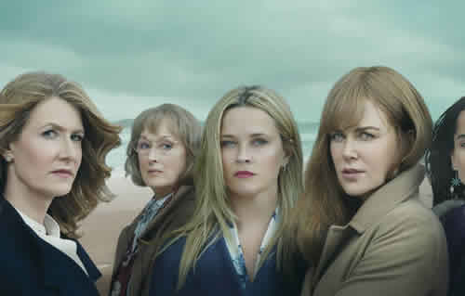
5.4.3 Converting a RGB image into Grayscale
▼Chapter 5 Data analysis with Python
工
► 5.4 Image processing with OpenCV
gray = cv2.cvtColor(image,cv2.COLOR_BGR2GRAY)
cv2.imshow(\"Showing gray image\", gray)
cv2.waitKey(0)
In[3]:
Out[3]:
-1

Slide 7
5.4.4 Detecting faces
▼Chapter 5 Data analysis with Python
► 5.4 Image processing with OpenCV
faceCascade=cv2.CascadeClassifier(cv2.data.haarcascades + \"haarcascade_frontalface_default.xml\")
faces=faceCascade.detectMultiScale(gray,scaleFactor=1.1,minNeighbors=5,minSize=(30,30))
for (x,y,w,h) in faces: cv2.rectangle(image,(x,y),(x+w,y+h),(0,0,255),8)
In[4]:

Slide 8
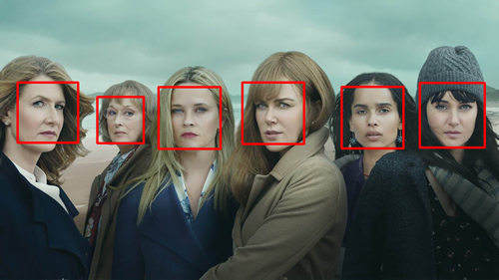
5.4.5 Showing images
▼Chapter 5 Data analysis with Python
► 5.4 Image processing with OpenCV
cv2.imshow(\"Window Name\", image)\n",
"cv2.waitKey(0)
In[5]:
-1
Out[5]:

Slide 9
5.4.6 Writing images
▼Chapter 5 Data analysis with Python
► 5.4 Image processing with OpenCV
cv2.imwrite(\"images/test_fr.png\",image)
In[6]:
Ture
Out[6]:

Slide 10


